Slide 1







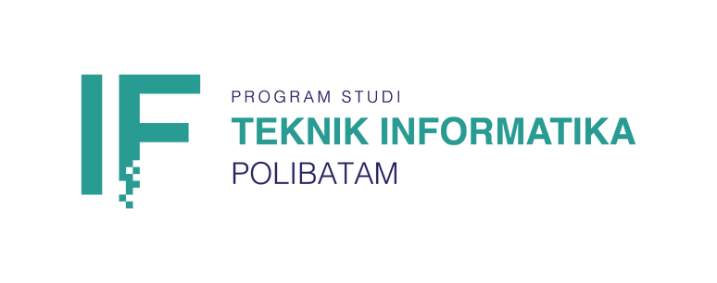
Artificial
Intelligence
PBL Progress IF-23-2-16
Next

Slide 2

Artificial
Intelligence
Generative Prompt Image Classification on Promptails Website
Project Manager: Agung Riyadi, S.Si. M.Kom
Project Proponent: Agung Riyadi, S.Si. M.Kom
Estimated Project Delivery: 6 months

Slide 3



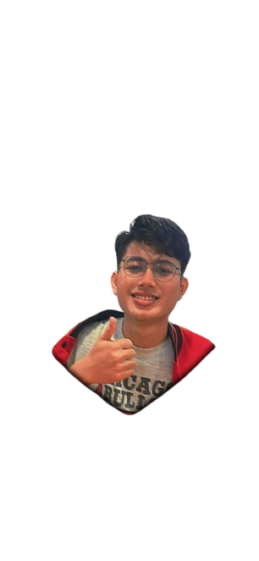

Artificial
Intelligence
Team Members
Samuel
3312211055
(Ketua)
Sechan Faradila
3312211004
M.Rafiansyah
3312211006
Putra Ramadhan
3312211008
Alpaber Tambunan
3312211073

Slide 4
Artificial
Intelligence
SCOPE
Determining Classification Models: Studied several classification models such as Convolutional Neural Network (CNN) and selected the most suitable one to be used in this project. Performed a comparison between models by testing the error at the end of the test.
Input: The input to the system is a prompt.
Data Augmentation: The data will be enhanced using augmentation techniques such as truncation and prompt correction to increase the diversity of the dataset.
Model Training: The classification model will be trained using the training dataset, and parameters will be adjusted to improve accuracy and generalisation.
Model Testing: The model will be tested on a separate test dataset to measure the actual performance.
Classification Criteria: Appropriate classification criteria will be determined for the generative AI results, such as specific categories or styles.

Slide 5
Artificial
Intelligence
General Design
Classification of generative AI images can be done in several steps. Firstly, select an appropriate classification model such as CNN, ViT, EfficientNet, or Swin Transformer. Compare several models and choose the best one based on complexity, accuracy, and inference speed. Enter a text prompt as input. Perform data augmentation on the prompts and images to increase the diversity of the dataset. Train the model using the labelled training set and optimise the hyperparameters. Test the model on a separate test set and evaluate accuracy, precision, recall, and F1-score. Classify prompts by category, style, or attributes. Use deep learning frameworks such as TensorFlow or PyTorch, pre-train the model with large datasets, and apply transfer learning to improve model performance. Perform cross-validation to ensure generalisation of the model.

Slide 6
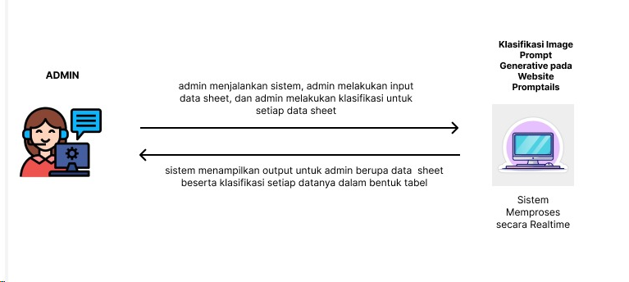
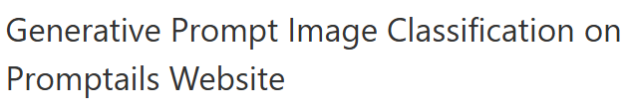
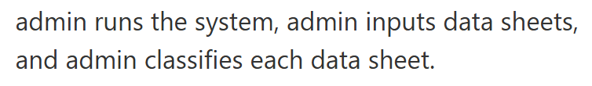
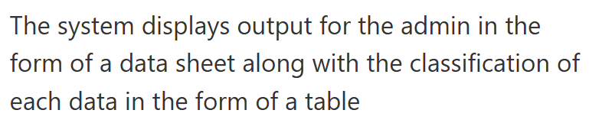
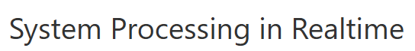
Overview

Slide 7
Artificial
Intelligence
Methods
Programming Language: Python, Natural Language Toolkit
Features: Predicting class from a prompt & predicting classes from prompts in the dataset

Slide 8
Artificial
Intelligence
Stages of Labour
Preprocessing Data
>Data Collection
>Data Cleaning
>Data Transformation
>Feature Selection
2.Pattern Recognition
>Classification
3.Model Evaluation
>Cross Validation
>Result Interpretation
4.Implementation
>Decision Making
>Model Implementation

Slide 9
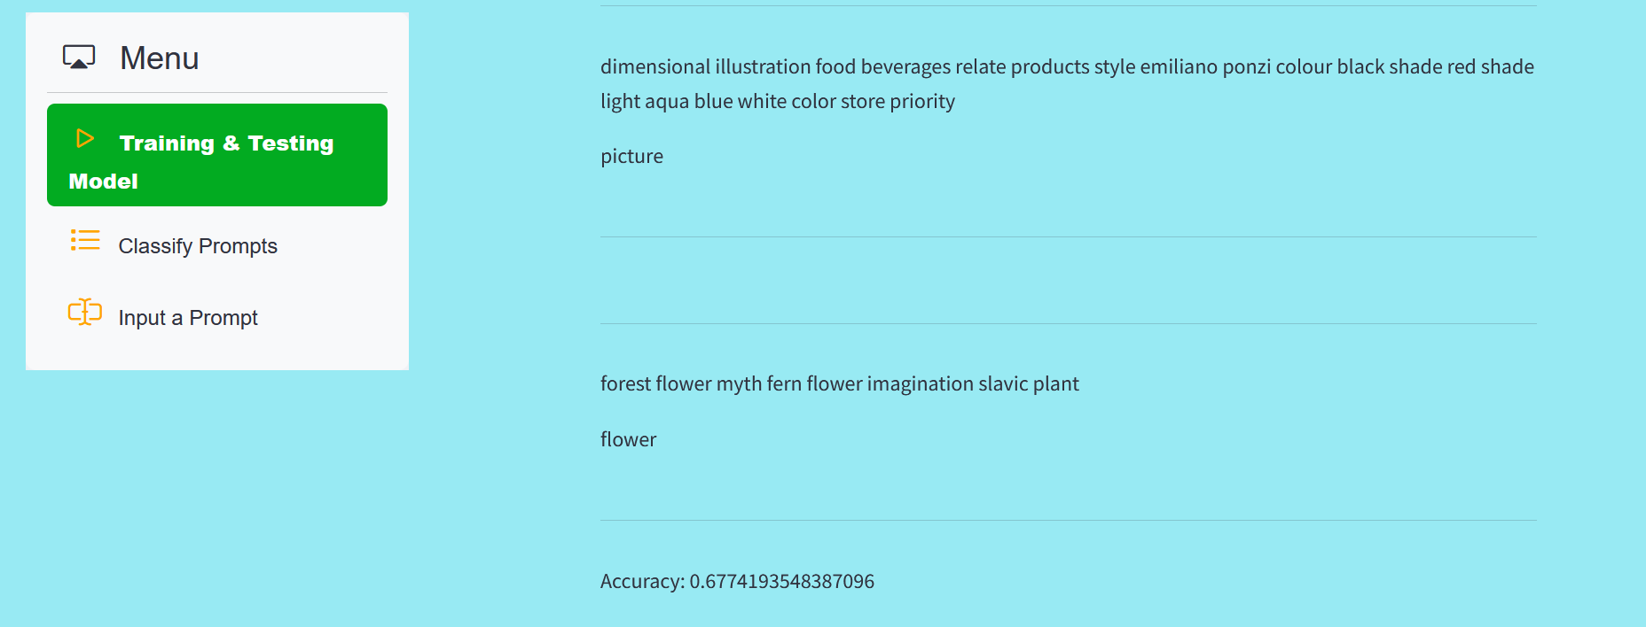
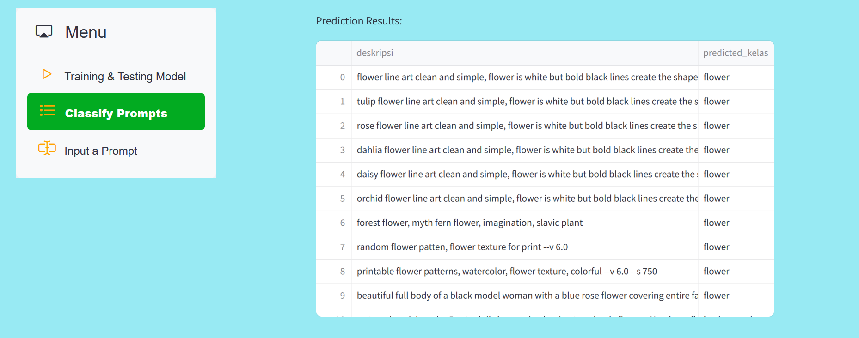
Artificial
Intelligence
Outputs to be Produced

Slide 10
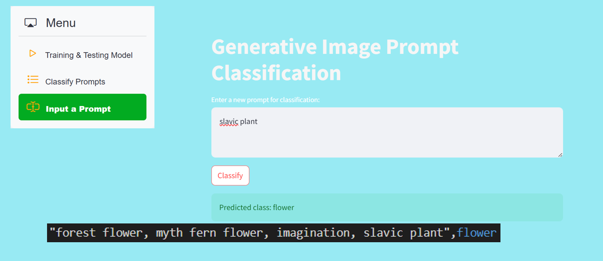
Artificial
Intelligence

Slide 11
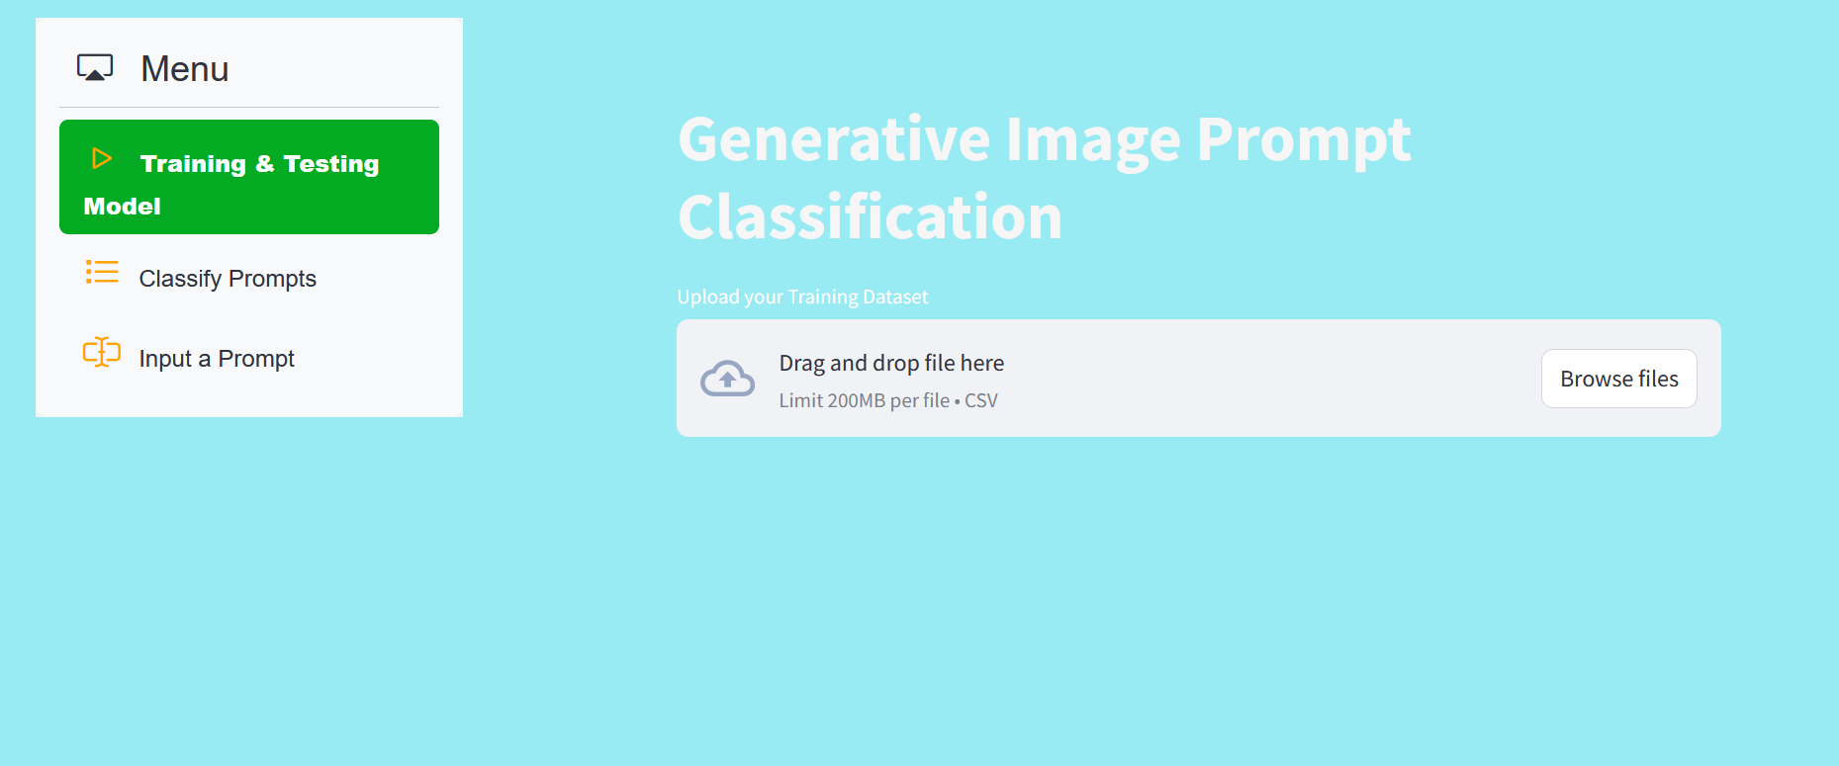
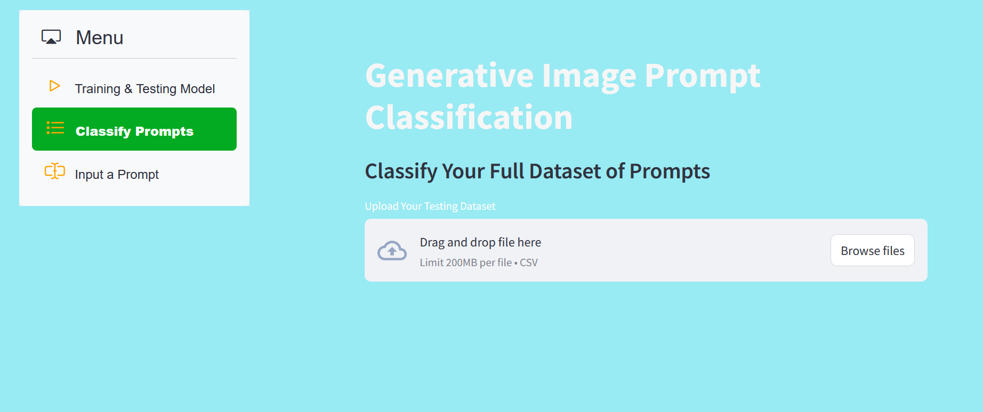
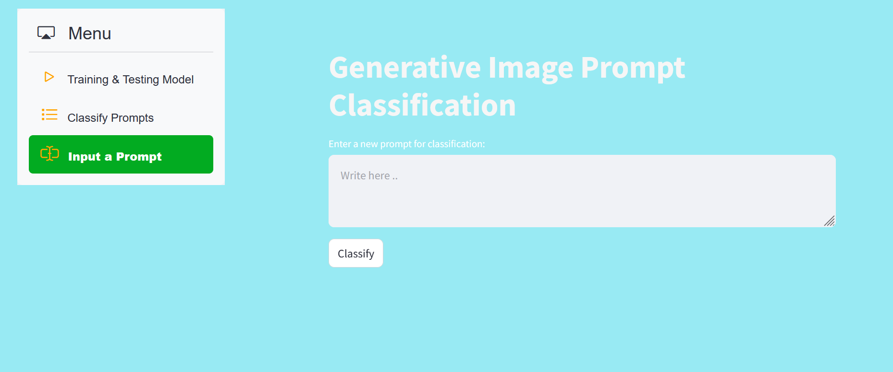
Desktop Application View

Slide 12









Artificial
Intelligence
Project Progress
Functional requirements
&
Non- functional requirements
ER Diagram
&
Relational Model
COMPLETE
COMPLETE
95.0%
completed percentage
Use Case Diagram
Use Case Scenario
Activity Diagram
Class diagram
Wireframe
&
Mock up
Complete
COMPLETE
PREPROCESSING DATA
DATA PREPROCESSING
PATTERN RECOGNITION
MODEL EVALUATION
IMPLEMENTATION
COMPLETE

Slide 13
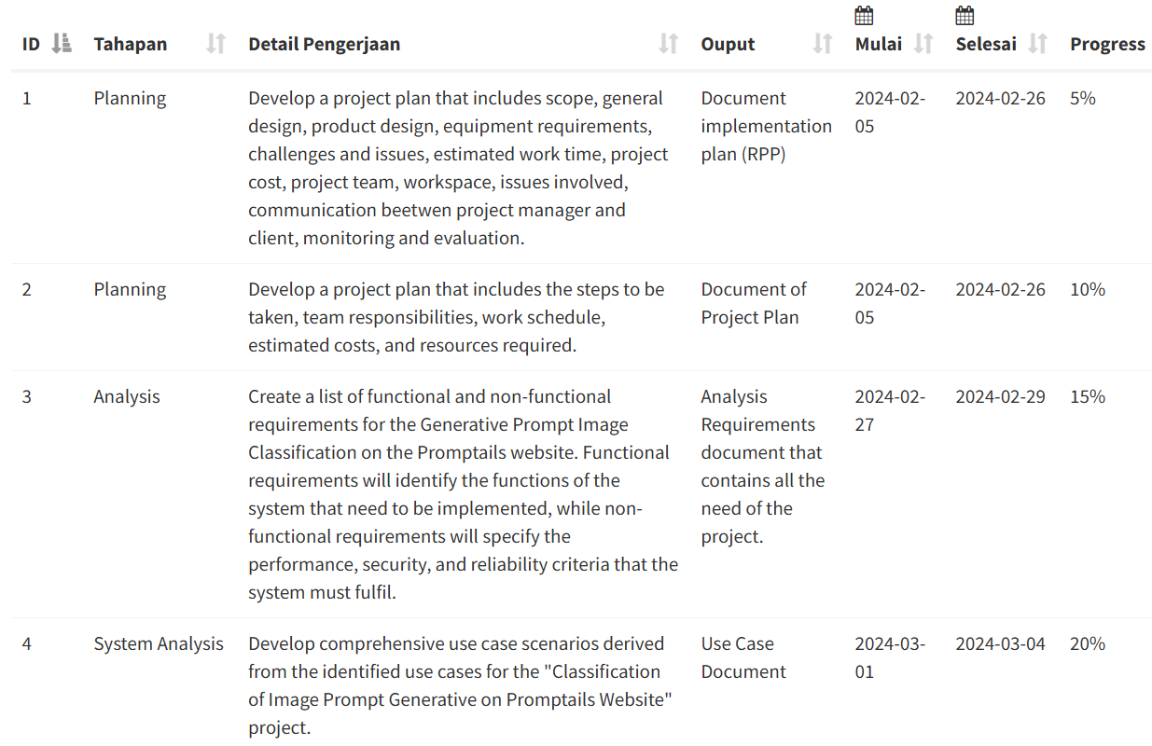
Artificial
Intelligence
Project Execution History

Slide 14
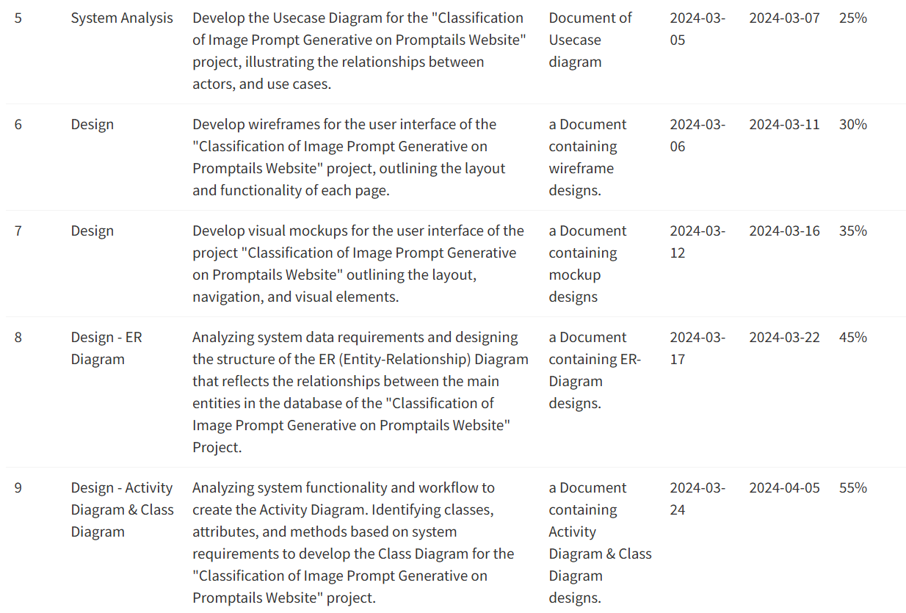
Artificial
Intelligence

Slide 15
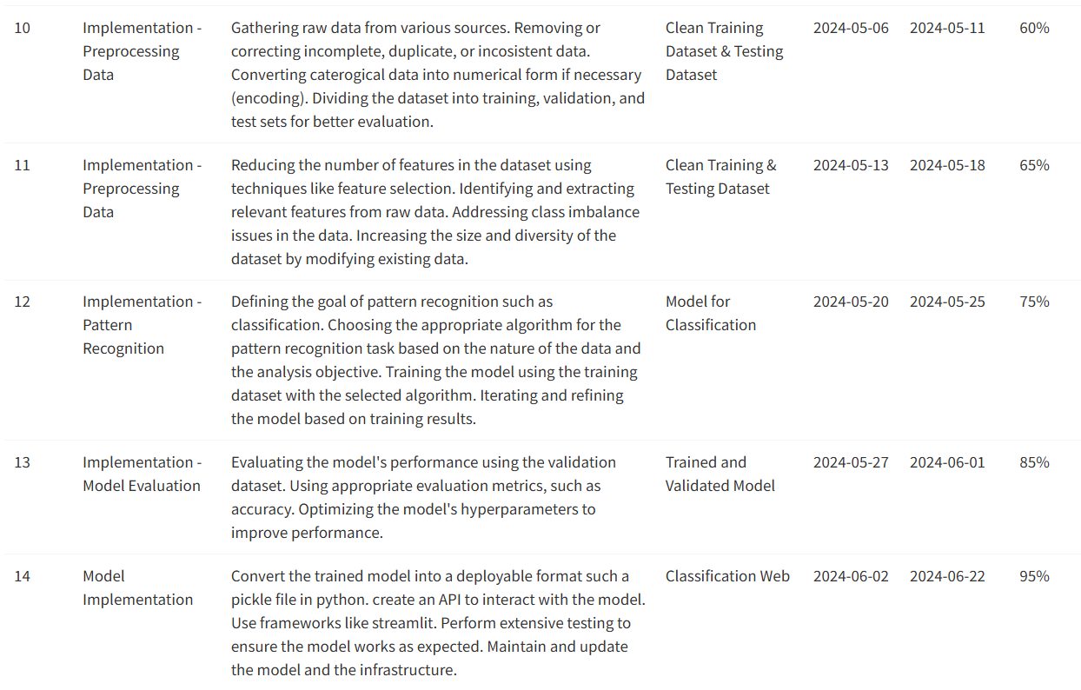
Artificial
Intelligence

Slide 16
Artificial
Intelligence
Constraints on Project Completion
Algorithm Complexity: The implementation of complex machine learning algorithms such as Convolutional Neural Networks (CNN) requires deep understanding and sufficient time for development and testing.
System Integration: Integrating the classification model into the Promptails Website platform requires a good understanding of the technological infrastructure used and ensuring compatibility between the existing system and the built model.
Time Management: It is difficult to organise time for teamwork, due to work and other matters.
Team Skills: Limited skills and experience of team members in Project development.

Slide 17
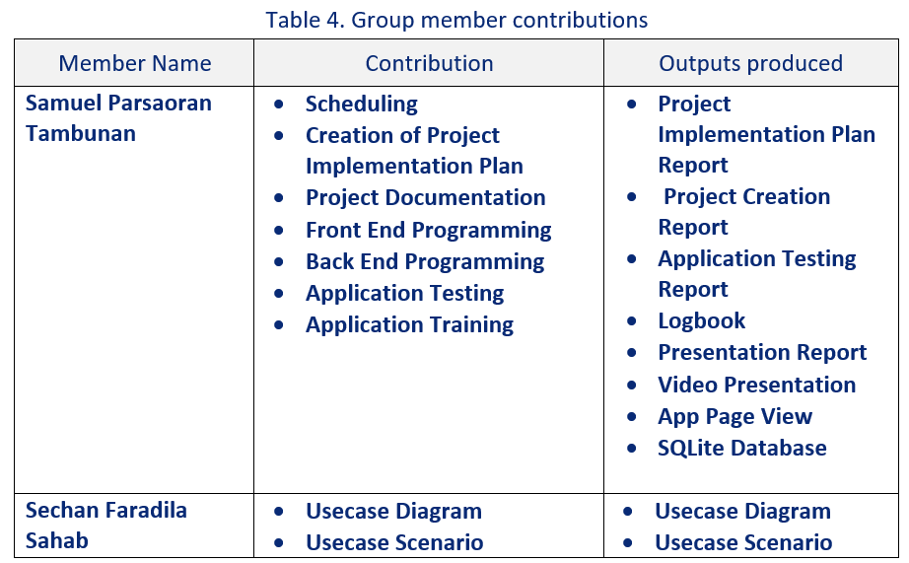
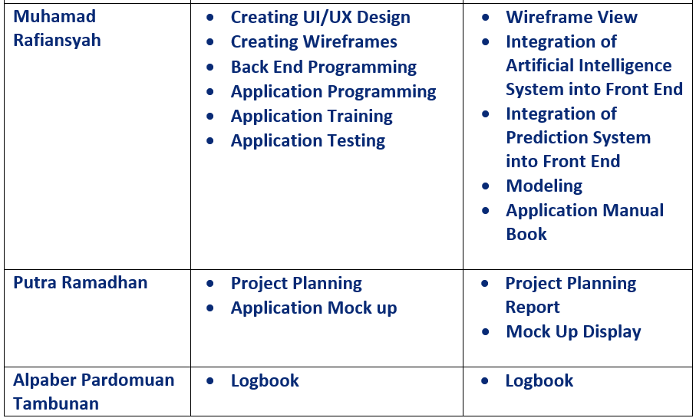
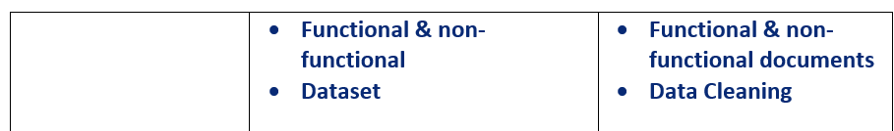
Artificial
Intelligence
Labour Division

Slide 18
Artificial
Intelligence
Next Work Plan
Classification Model Building (Done)
Data Augmentation (Done)
Model Training and Evaluation (Done)
Integration with Website Promptails (Done)
Testing and Validation (Done)
Monitoring and Controlling (Done)
Final Evaluation (On Progress)

Slide 19
Artificial
Intelligence
Thank You
PBL IF-23-2-16
Next

